Slide 1
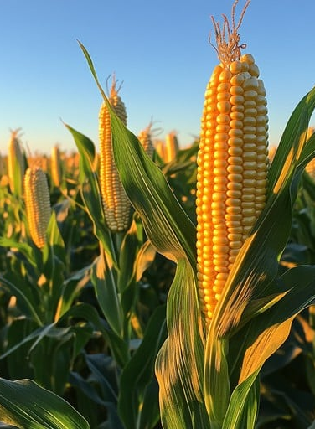
INFO: 526 Visualizing Climate Impacts on Corn Price
Trend setters

Slide 2
Team Members:
Kkshitij Kapadia
Het Patel
Davo Acevedo Cardona
Muhammed Aamir Naveed

Slide 3
AGENDA
Introduction
Data Collection & Preprocessing
Exploratory data Analysis
Climate impact on corn Price
conclusion

Slide 4
INTRODUCTION
Corn is a staple crop essential to global food systems and economies.
Climate factors like temperature and precipitation influence both corn yields and market prices.
This study explores how increasing global temperatures and uncertain rainfall patterns relate to corn prices over time.
⚠️ Note: We are exploring correlations, not causal relationships. This is an initial data-driven look, not a definitive cause-effect analysis.

Slide 5
DATA COLLECTION

Slide 6
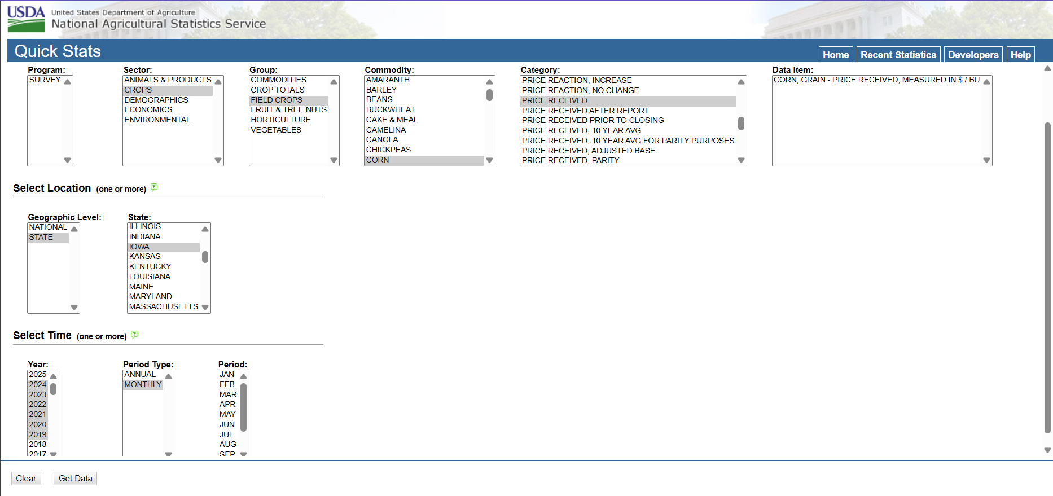
CORN PRICE

Slide 7
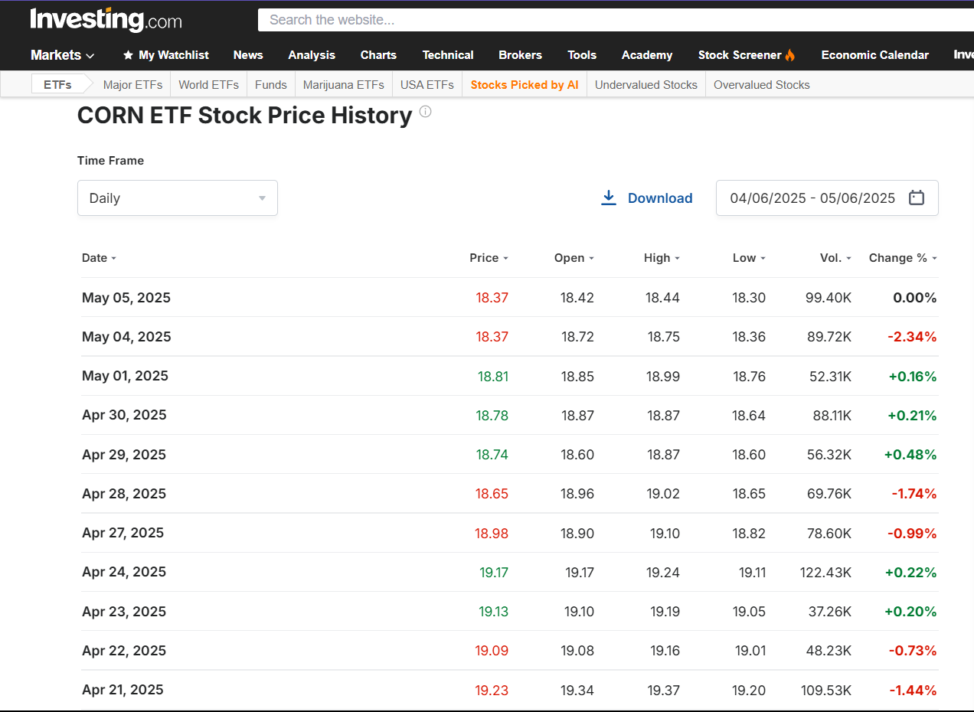
CORN STOCK PRICE

Slide 8
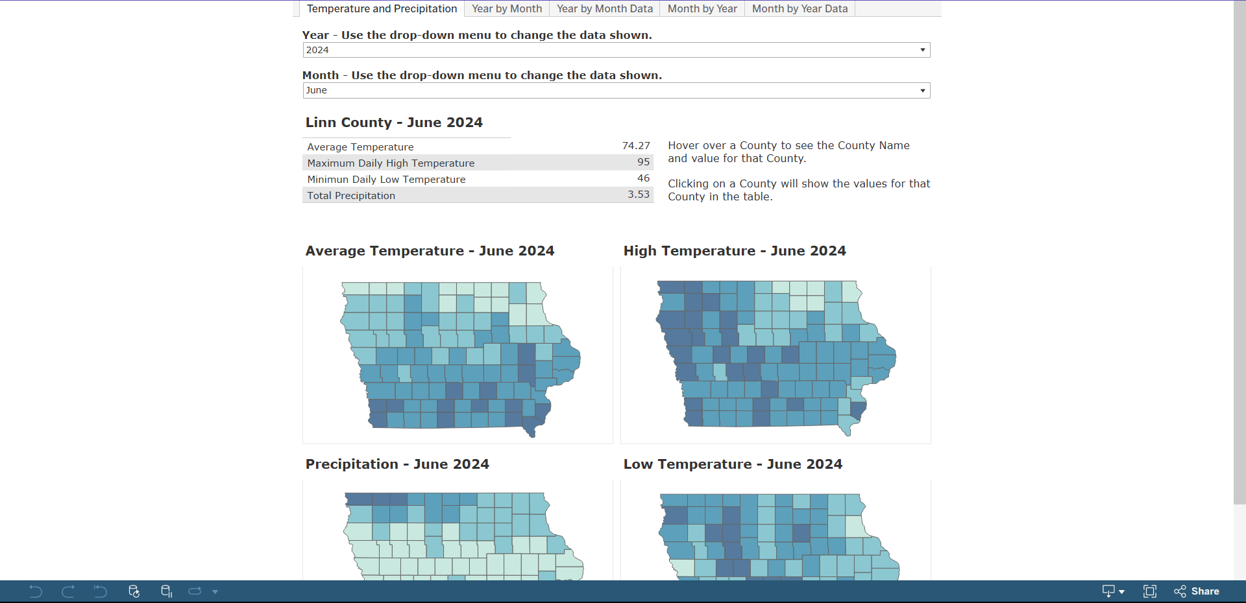
TEMPERATURE AND PRECIPITATION DATA

Slide 9
PREPROCESSING
Collected data was already clean.
It had no null values
The historical prices were adjusted for inflation in both the corn price and stock price dataset.

Slide 10
EDA

Slide 11
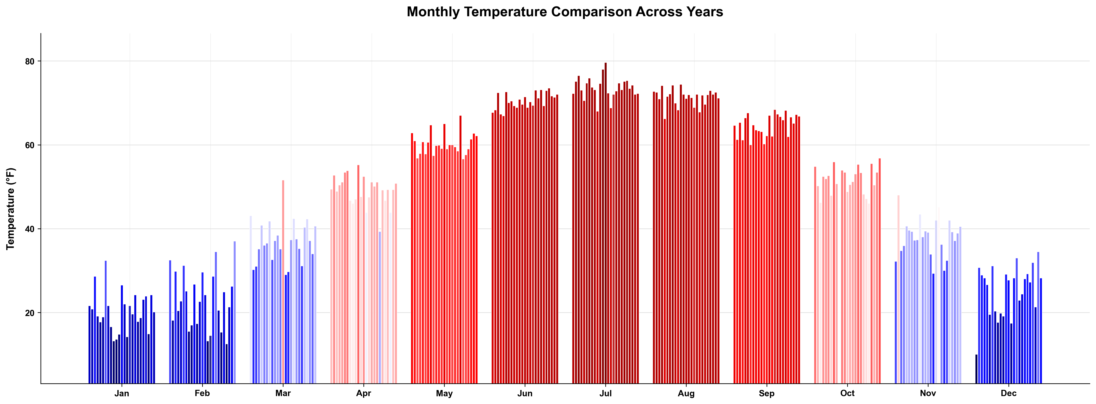
TEMPERATURE

Slide 12
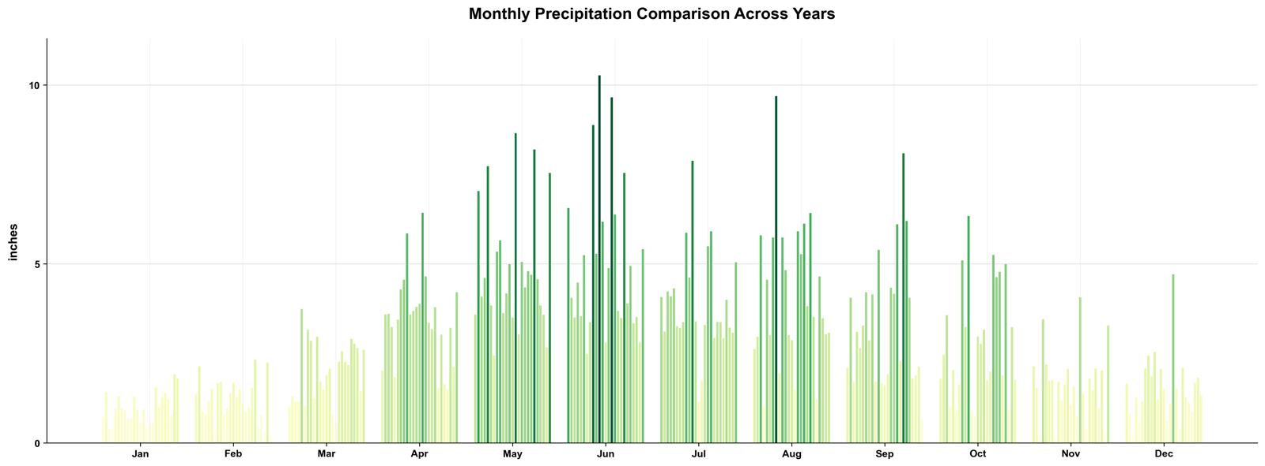
PRECIPITATION

Slide 13
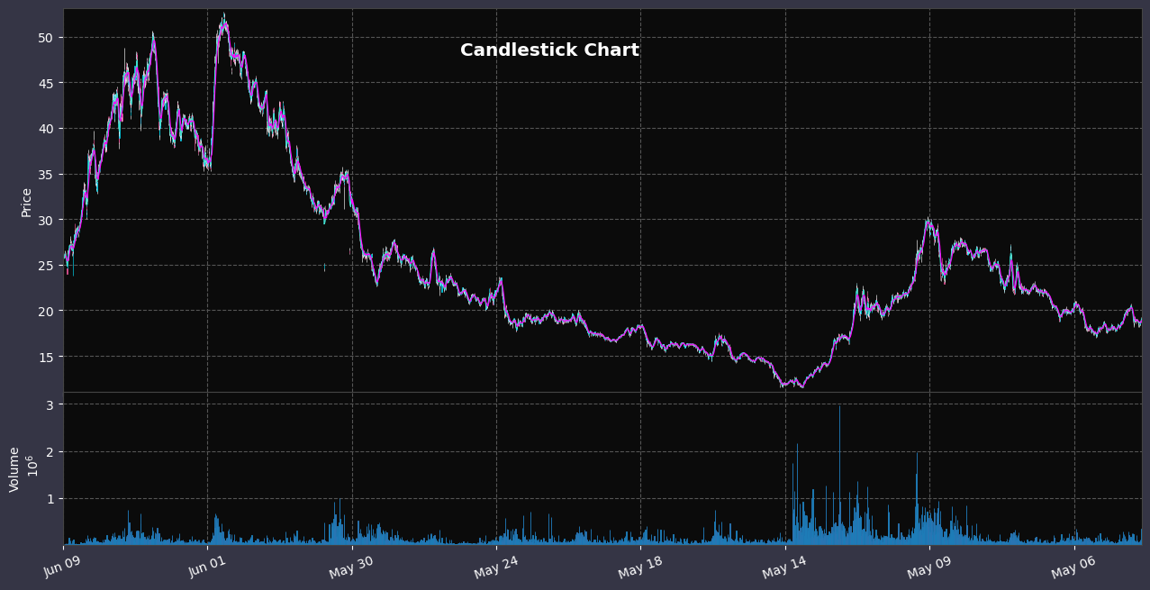
STOCK PRICE

Slide 14
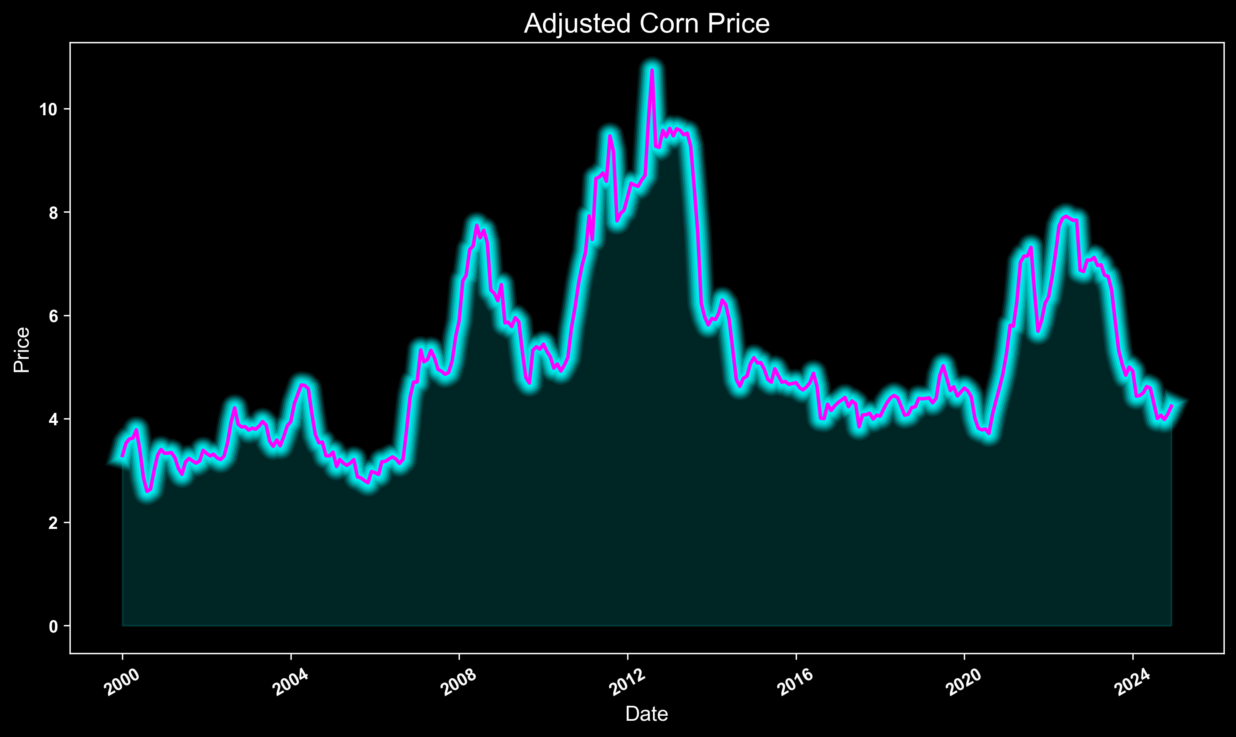
CORN PRICE

Slide 15
Questions

Slide 16
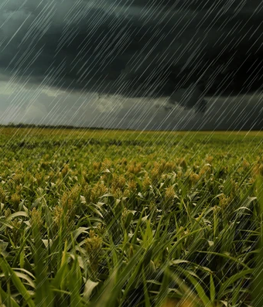
How Rainfall affects the Price of Corn

Slide 17
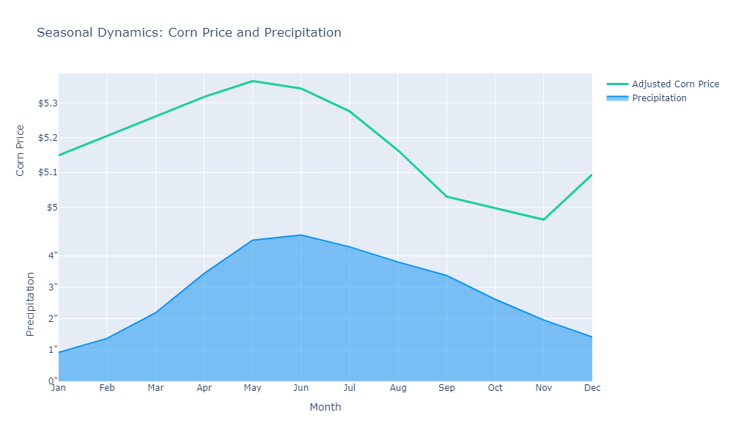
SEASONAL EFFECTS

Slide 18
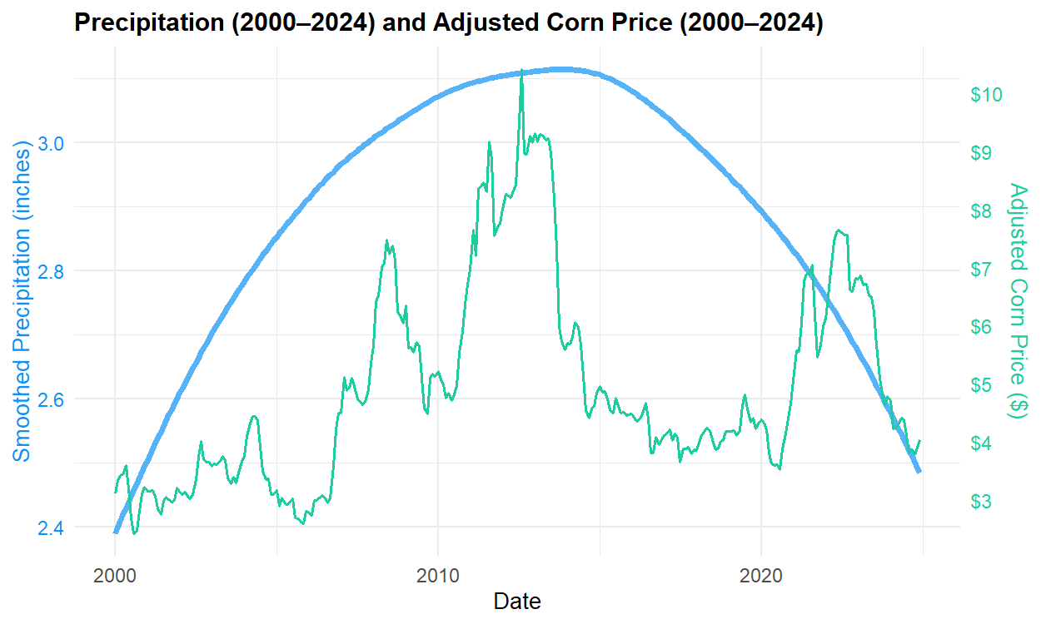
LONG TERM EFFECTS

Slide 19
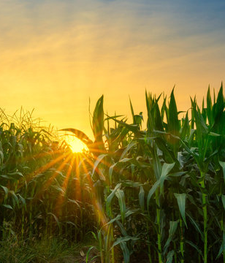
How Temperature affects Stock Price of Corn

Slide 20
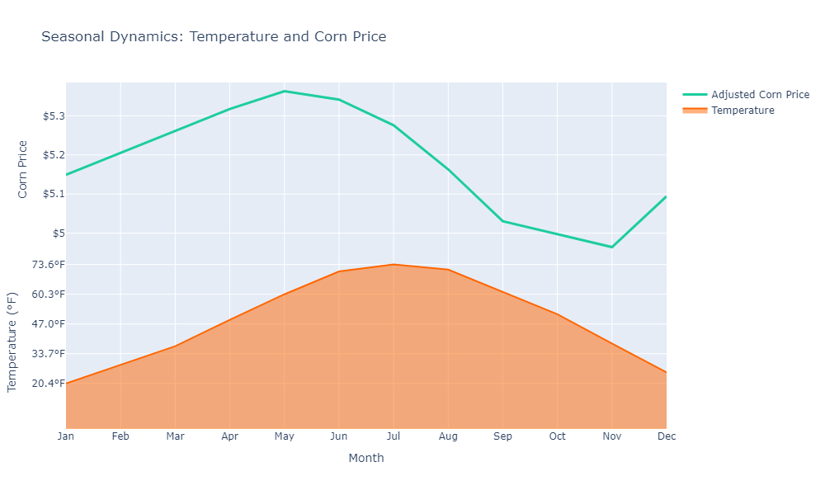
SEASONAL EFFECTS ON CORN PRICE

Slide 21
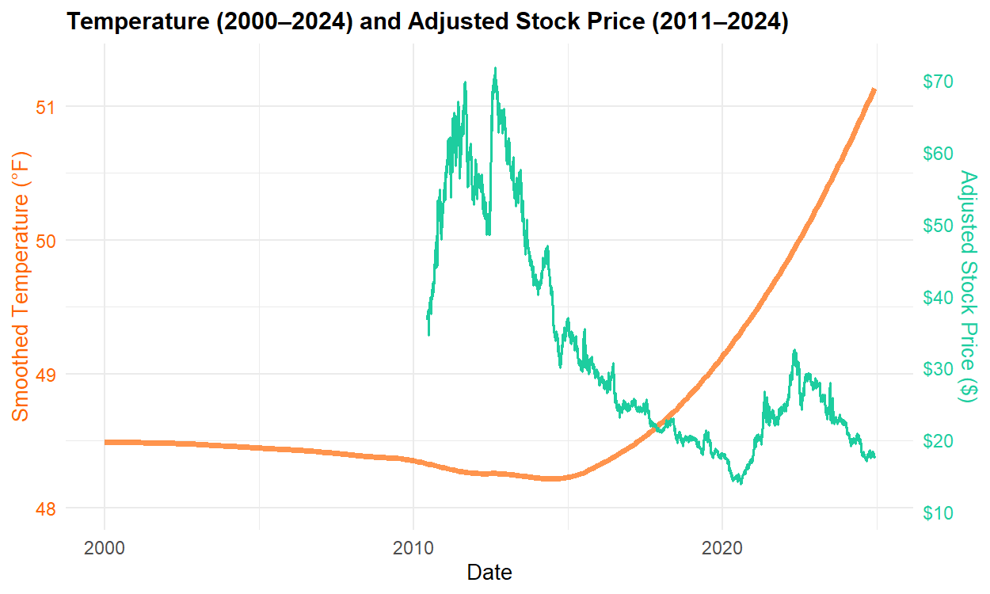
LONG TERM EFFECTS ON STOCK PRICE

Slide 22
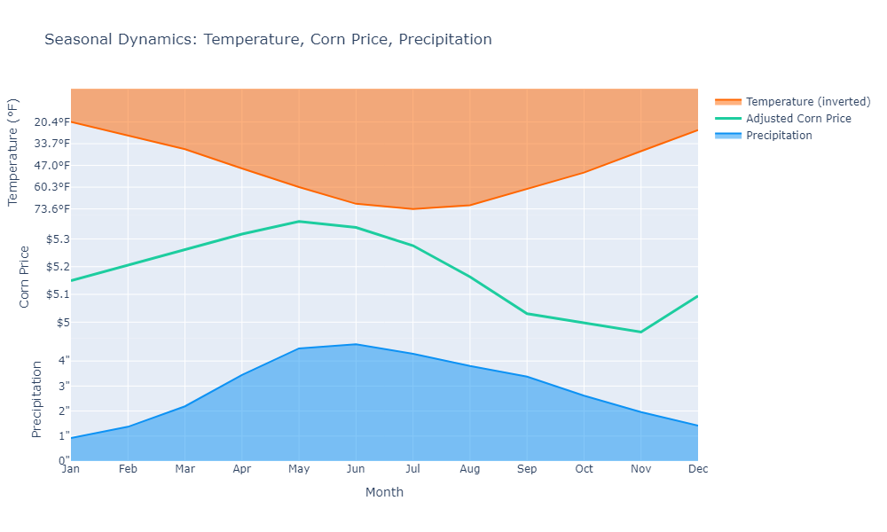
COMBINING SEASONAL PLOTS

Slide 23
CONCLUSION

Slide 24
KEY TAKEAWAYS
Corn prices typically peak during late spring and early summer which aligns with optimal rainfall and moderate temperatures.
As temperatures rise in mid-summer corn prices often grows that indicate potential heat stress on crop yields.
Adjusting for inflation reveals real economic patterns and removes misleading price trends due to currency changes.
The fact that there are warmer temperatures does not mean higher profits.
Techniques like LOESS smoothing and dual-axis plots make complex multi-variables relationships easier to interpret and communicate.

Slide 25
Thank you

